Slide 1
You did it! 🥳🎉
TIP102
Week 10
Notes:
🌟 Purpose: Congratulate students for completing the course and set a celebratory tone.
✅ What should I be doing?
Acknowledge students’ hard work and perseverance.
Build excitement for the session and celebrate their journey.
🎙️ What should I be saying?
Congratulations, everyone! You’ve reached the final session of TIP102! This is such an incredible accomplishment, and you should all feel proud of the effort and dedication you’ve put into this course.
Today, we’re going to celebrate, reflect on what we’ve achieved, and wrap up with a final round of collaborative problem-solving.
🙌🏽 How should I engage students?
Ask: "What’s one thing you’re most proud of accomplishing during TIP102?" Highlight a few responses to foster community and celebration.

Slide 2
1 | Welcome! 👋🏽 | 0:00 - 0:15
2 | Celebrate 🎉🎉🎉🎉🎉🎉 | 0:15 - 0:30
3 | BREAK | 0:45 - 0:50
4 | Collaborative Problem Solving | 0:50 - 1:50
5 | Wrap Up | 1:50 - 2:00
Notes:
🌟 Purpose: Provide a clear outline of the final session's activities.
✅ What should I be doing?
Review the schedule and set expectations for the flow of the session.
🎙️ What should I be saying?
Here’s what we have planned for our final session: We’ll start with a welcome and celebration, followed by a short break. Then, we’ll dive into one last round of collaborative problem-solving before wrapping up with reflections and final reminders.
🙌🏽 How should I engage students?
Pause and ask if anyone has questions about the agenda.

Slide 3
Welcome! 👋🏽
15 minutes

Slide 4


Turn on your cameras
Fill out the entry ticket
Notes:
🌟 Purpose: Encourage visual engagement to foster connection during the session.
✅ What should I be doing?
Prompt students to enable their cameras and submit the entry ticket.
🎙️ What should I be saying?
Let’s kick off our session by turning on our cameras!
Also, don’t forget to fill out the entry ticket to help us organize breakout rooms later.
🙌🏽 How should I engage students?
Use humor or compliments: "Let’s see those smiles!"
Acknowledge and thank students who turn on their cameras.

Slide 5
5 minutes

Slide 6
Goals Check In
Padlet

Slide 7
UPDATE ME!
Review the feedback from the previous Session Survey and note key themes here to share with the class.
DELETE THIS BOX WHEN YOU’RE DONE!
+
-
Notes:
🌟 Purpose: Share feedback from the previous session and highlight areas of success and improvement.
✅ What should I be doing?
Summarize feedback from the previous session's survey and present key takeaways.
🎙️ What should I be saying?
From your feedback, it seems many of you enjoyed [highlighted aspect]. One suggestion was [area for improvement]. We’ll work on that today.
🙌🏽 How should I engage students?
Ask: "Does anyone have additional feedback or suggestions?"

Slide 8

Announcements & Reminders
UPDATE ME!
Add any announcements or reminders. These will often come from the SSL or Liz, so be sure to check in with them to see if there are any that need to be added here if that information hasn’t been shared with you already.
DELETE THIS BOX WHEN YOU’RE DONE!

Slide 9
15 minutes
Celebrate! 🎉🎉🎉🎉

Slide 10
With your breakout group . . .
Share something you are proud of from the course, such as a skill you developed or a challenge you overcame.
Then add to the Accomplishments Showcase! This can be:
Highlights
Shout-outs
Inspirational messages or quotes
UPDATE ME!
Make your own Padlet for students to contribute to OR replace this altogether with your own celebratory activity.
DELETE THIS BOX WHEN YOU’RE DONE!
Notes:
🌟 Purpose: Create a collaborative and reflective space to celebrate individual and group accomplishments.
✅ What should I be doing?
Facilitate a celebratory activity where students share their achievements and add them to a showcase (e.g., Padlet or chat).
🎙️ What should I be saying?
It’s time to celebrate! Break into your groups and share something you’re proud of—whether it’s a new skill, a challenge you overcame, or a milestone you reached in this course.
Let’s also contribute to the Accomplishments Showcase. Add your highlights, shout-outs, or inspirational messages. Think of this as a virtual trophy wall!
I’ve shared the link to our showcase in the chat. Take a moment to add your contributions now.
🙌🏽 How should I engage students?
Encourage sharing by giving examples: "I’m proud of how engaged you’ve been in solving problems as a group—what’s something you’re proud of?"
Acknowledge specific contributions in the showcase and thank students for their participation.

Slide 11
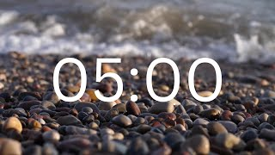
Break Time!
Take 5 mins to step away from the computer. Feel free to turn off your camera and return promptly after 5 mins.
Notes:
🌟 Purpose: Provide a short break to refresh and re-energize.
✅ What should I be doing?
Announce the break and remind students to return on time.
Play the countdown timer video (be sure to share sound).
🎙️ What should I be saying?
Let’s take 5 minutes to step away from the screen. Be sure to return promptly.

Slide 12
Game Plan
General prepping?
Pitch
Practice problem checklist
Leetcode
Behavioral
Interview Scheduled?
Research the company
Mission statement, core values
Questioned asked before (sometimes leaked!)

Slide 13
Pitch
“Tell me about yourself”
30s - 1 min
Background
Interest
Fit

Slide 14
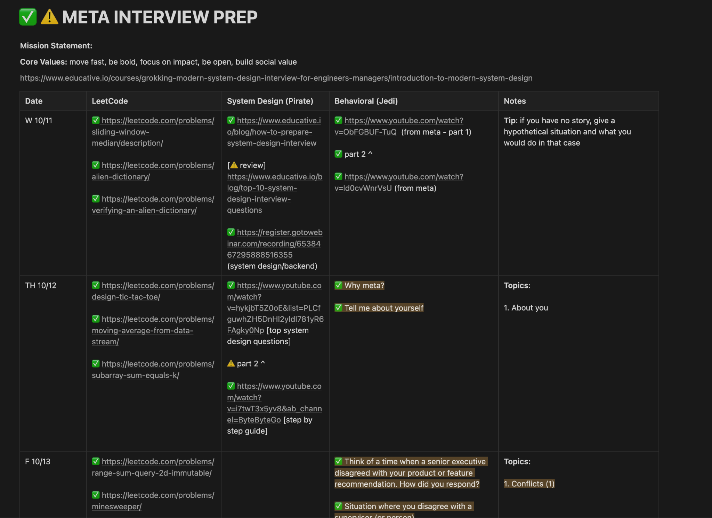
Game Plan Example:

Slide 15
Questions for the Interviewer
Can you describe what your day as an engineer looks like?
Do you have any advice for me going forward and/or for my interview today?
Position
Can you tell me a little more about what you do? The projects? What tools do you work with most?
Greatest challenges in your role?
Company
What do you enjoy most about working for Meta?
What are the biggest challenges/opportunities the company/your team is currently facing?
How does [Company] support continued education? Seminars, workshops, training?
People/Culture
How would you describe the culture of the company?
Performance
How are responsibilities/performance measured? Timeline of projects? Communication between teams?
How is the onboarding process?
Additional feedback on interview. Any other details I can provide that would be helpful in answering your questions/additional questions that I can answer?

Slide 16
Behavioral Questions
STAR method
Situation
Task
What
Action
How did you show time management, prioritizing, communication, leadership, etc…
Result
How did the solution help the company? How was the solution explained to everyone? How is it going to be prevented next time?

Slide 17
Behavioral Questions
Examples:
About you
Conflict
People skills
Leadership
Failures
Proud/successful moment
Ambiguity
Comfort zone
Time management
(Conflicting) priorities
Pressure
Deadlines
Outside OKR
Learning
Persuasion/backbone
Feedback

Slide 18
Behavioral Questions
Be honest, don’t make something up.
“I don’t have a first hand experience on this, but if a situation like this did happen, I would…”

Slide 19
Differences Between Internship & Full Time
System design interview
Behavioral question expectations
Setting technical direction
Designing and/or implementing a technical process, either within a team or more broadly across a wider organization (at scale)
Metric and goal setting
Roadmap planning and ownership
Working cross-functionally to drive projects across a platform, organization, or team
Managing and aligning stakeholders
Resolving conflict (this is important because we will at times disagree….but doing it well and respectful is the key)

Slide 20
At the Job: Setting Goals
PAWN
Prepare
Assess your readiness
Work hard
Narrate, nominate, nail
https://docs.google.com/document/d/1eXqqKAtNO5gCspkVukxT0mFQNBg9CrnJgk-7B7m71ko/edit?tab=t.0

Slide 21
Assessment Table
https://docs.google.com/document/d/1eXqqKAtNO5gCspkVukxT0mFQNBg9CrnJgk-7B7m71ko/edit?tab=t.0

Slide 22
Collaborative Problem Solving
60 minutes

Slide 23
60 minutes
🏃🏽 Navigate to your breakout room.
👋🏽 Introduce yourselves!
🧑🏽‍💻 Work on the problems for your selected unit.

Slide 24
Wrap Up
10 minutes

Slide 25
Notes:
🌟 Purpose: End the session on a positive note.
✅ What should I be doing?
Prompt students to share their reflections in the chat.
🎙️ What should I be saying?
Let’s celebrate your wins. Share one good thing you learned or accomplished today!
🙌🏽 How should I engage students?
Read a few responses aloud and celebrate with enthusiasm.

Slide 26


Session Survey Time!
Notes:
🌟 Purpose: Gather feedback to improve future sessions.
✅ What should I be doing?
Share the survey link and emphasize its importance.
🎙️ What should I be saying?
Your feedback helps us make these sessions even better. Please take a moment to complete the survey.
🙌🏽 How should I engage students?
Thank students for their input and explain how feedback has been used in the past.

Slide 27

Final Reminders
Finish the problem sets for additional practice
Other resources:
Grind 75
Blind 75
Grokking the system design interview
RESHADED
Take the weekly HackerRank assessment by Sunday @ midnight
You have access to slack, course portal and career center forever
Certificates will be processed 5-7 days after course completion
Notes:
🌟 Purpose: Provide a short break to refresh and re-energize.
✅ What should I be doing?
Announce the break and remind students to return on time.
Play the countdown timer video (be sure to share sound).
🎙️ What should I be saying?
Let’s take 5 minutes to step away from the screen. Be sure to return promptly.

Slide 28

Final Reminders
https://www.linkedin.com/in/allisonjchan

